Slide 1
INFO1112 Tutorial
Week 7

Slide 2
Mid-Semester Quiz – How was it?
Please let me know your:
thoughts
feelings
and rants!
I’m looking for feedback that I can hopefully pass on to the teaching team!

Slide 3
Homework stuff
Homework 3 – 1 Week Extension (Now due 17th of September 11:59pm)
If you have completed Homework 3 already we can still have your interview this lesson
Homework 4 – Still due 24th of September 11:59pm

Slide 4
Git setup tutorial

Slide 5
Brief summary of this week’s content

Slide 6


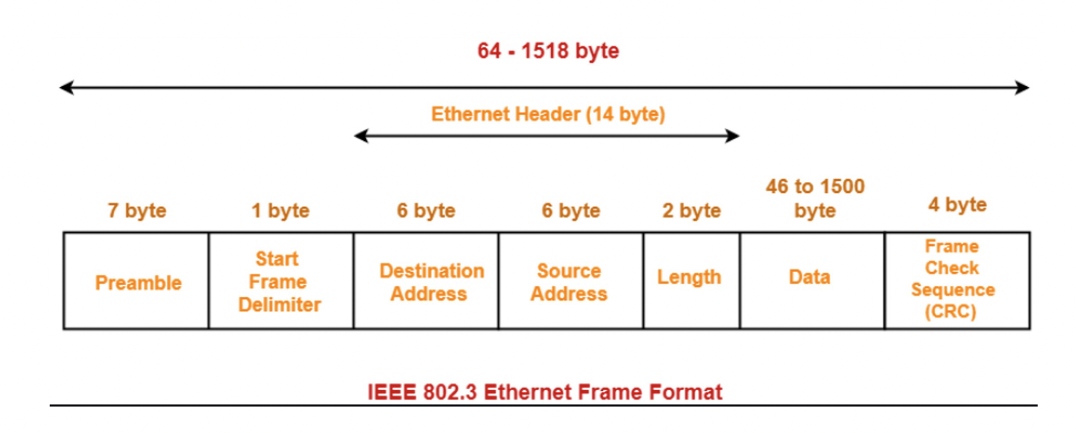

7.1 – IP Routing
Revision from last week:
Ethernet – protocol in the “Link” (lowest) layer of internet protocol suite
Ethernet packets are used to transfer data from one point to another point in a network (e.g. from one router to another)
Packets only exist for this single “hop”, before they are unwrapped and wrapped up again to get to the next point
Uses MAC (Media access control) address to store information on source, and find destination of “hop”
Unique address for all devices which connect to the internet

Slide 7
7.1 – IP Routing
Internet Protocol (IP) – used for communication between any two devices connected to the Internet
Wraps packets in higher protocol layers, such as
Transmission Control Protocol (TCP)
User Datagram Protocol (UDP)
Internet Control Message Protocol (ICMP)
ICMP – protocol which dictates a simple “echo” request
When the intended receiver receives this packet with an echo request, it re-sends the packet back to the sender
Used in ping command
Has “time to live” (ttl) property, which states maximum number of “hops” packet can take
Once maximum number of hops is reached, the receiving device (if it is not the intended receiver) sends the packet back with a “time exceeded” message
Used in traceroute command – and we will have a look at designing this ourselves!

Slide 8
7.1 – IP Routing
Recap on types of networks
Local Area Networks (LAN)
Wide Area Networks (WAN)
How is data sent on these networks?
LAN
Data (ethernet packets, also known as frames), are initially broadcast to all connected devices
Frames are only decoded by a device if the destination MAC address is correct
Initial frame sent is a special broadcast frame
MAC address = 1111…..1111
Can be read by all connected devices
Router sends frame asking “which device has IP address xxx.xxx.xxx.xxx?”, and a response is received by the corresponding device containing the MAC address
Router can then send ethernet frame to corresponding device

Slide 9
7.1 - IP Routing
Recall that we had local and public IP addresses
Local IP addresses have a limited range
Anything outside this range is a public IP address on the Internet
Typically, LAN has 256 addresses
How can we test this range?
Recall masking from Emulator lab
How can we use masking to check if our IP address is public or local?
IP addresses outside this range are passed to a “gateway” IP address
Gateway will pass connection to a WAN

Slide 10
7.1 – IP Routing
WAN routing
Internet Assigned Numbers Authority (IANA) assigns IP addresses
Delegates regional assignment to local authorities
Recall IPv4 uses 32 bits (4 byte) addresses
What could be the problem with this?

Slide 11
7.1 – IP Routing
IPv4 limited addresses:
IANA designates certain addresses as “private”
These can be reused in local networks
Example: 192.168.0.0– 192.168.0.255
If a device in a LAN wants to talk to another device in a different LAN, we must translate the private IP address to a public one
Done through Network Address Translation (NAT) at router
Each router in a LAN remembers translation, so it can translate a public IP to a private one

Slide 12
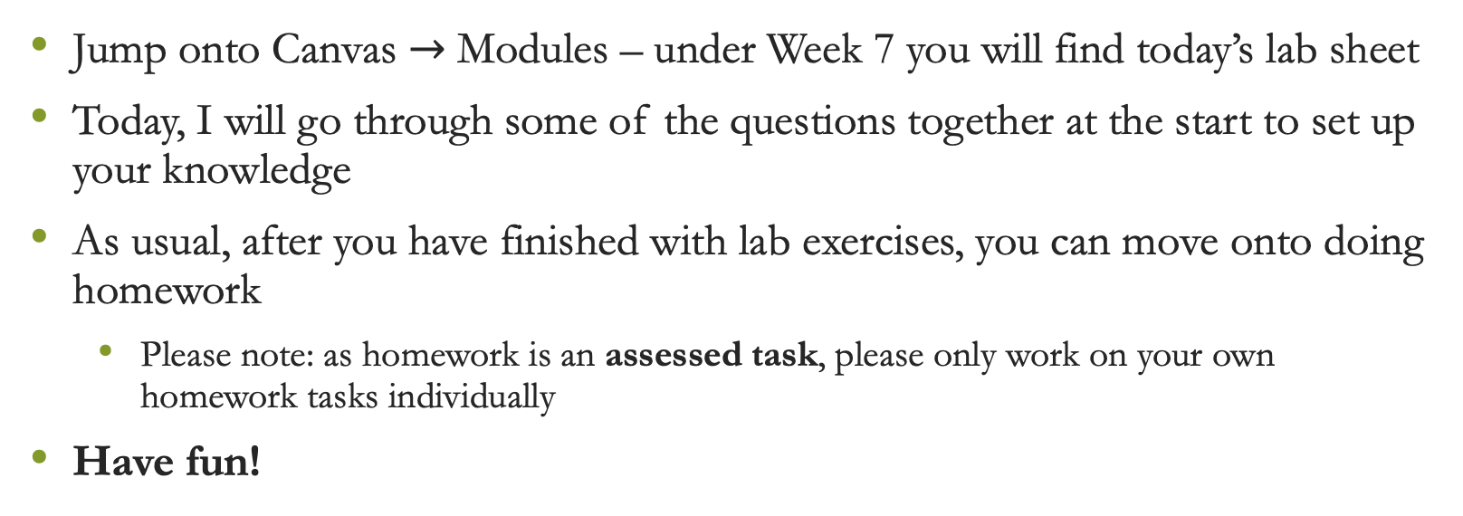
Lab exercises
Jump onto Canvas $→$ Modules – under Week 7 you will find today’s lab sheet
Today, I will go through some of the questions together at the start to set up your knowledge
As usual, after you have finished with lab exercises, you can move onto doing homework
Please note: as homework is an assessed task, please only work on your own homework tasks individually
Have fun!

